Slide 1
EEE 342/ETE418
Control Engineering
Fall 2019
Lecture # 04
14 October 2019

Slide 2

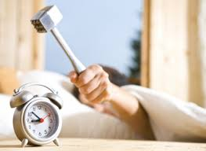


Poles, Zeros, and System Response
The output response:
the forced response.
the natural response.
Natural response
forced response
unhappy
happy

Slide 3
Poles, Zeros, and System Response
solving a differential equation
taking the inverse Laplace transform
these techniques are laborious and time-consuming
The poles of a transfer function are the values of the Laplace transform variable, s, that cause the transfer function to become infinite
The zeros of a transfer function are the values of the Laplace transform variable, s, that cause the transfer function to become zero,

Slide 4
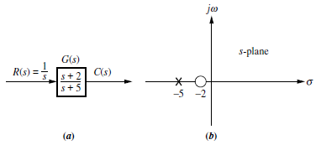
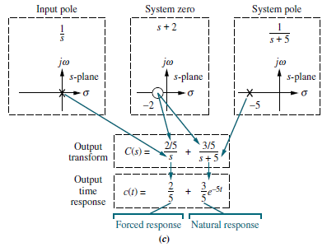
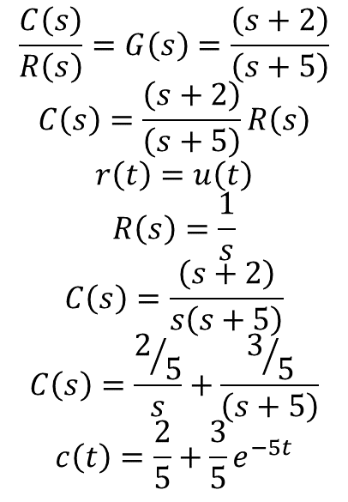
Poles, Zeros, and System Response
A pole of the input function generates the form of the forced response
A pole of the transfer function generates the form of the natural response.
$$\frac{C\left(s\right)}{R\left(s\right)}=G\left(s\right)=\frac{\left(s+2\right)}{\left(s+5\right)}$$
$$C\left(s\right)=\frac{\left(s+2\right)}{\left(s+5\right)}R\left(s\right)$$
$$r\left(t\right)=u\left(t\right)$$
$$R\left(s\right)=\frac{1}{s}$$
$$C\left(s\right)=\frac{\left(s+2\right)}{s\left(s+5\right)}$$
$$C\left(s\right)=\frac{2/5}{s}+\frac{3/5}{\left(s+5\right)}$$
$$c\left(t\right)=\frac{2}{5}+\frac{3}{5}e^{−5t}$$

Slide 5
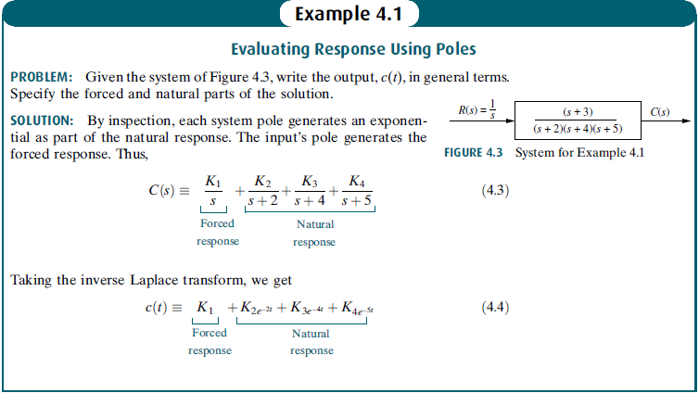
Poles, Zeros, and System Response

Slide 6
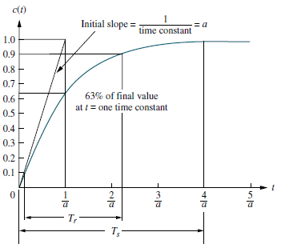
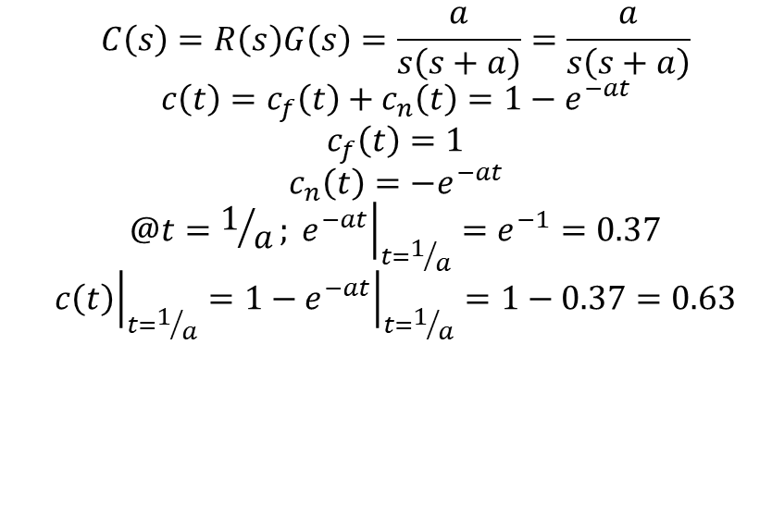
First-Order Systems
$$C\left(s\right)=R\left(s\right)G\left(s\right)=\frac{a}{s\left(s+a\right)}=\frac{a}{s\left(s+a\right)}$$
$$c\left(t\right)=c_{f}\left(t\right)+c_{n}\left(t\right)=1−e^{−at}$$
$$c_{f}\left(t\right)=1$$
$$c_{n}\left(t\right)=−e^{−at}$$
$$@t=1/a; {\left.e^{−at}\right|}_{t=1/a}=e^{−1}=0.37$$
$${\left.c\left(t\right)\right|}_{t=1/a}={\left.1−e^{−at}\right|}_{t=1/a}=1−0.37=0.63$$
1/a the time constant of the response
the time constant can be described as the time for eat to decay to 37% of its initial value.
the time constant is the time it takes for the step response to rise to 63% of its final value

Slide 7
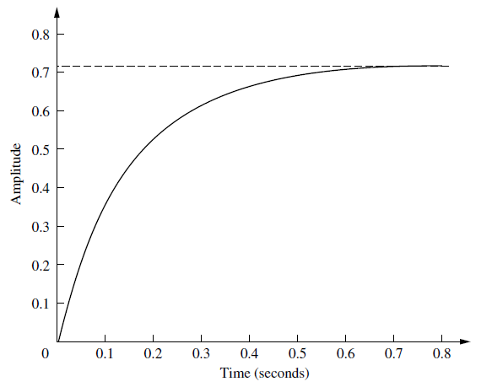
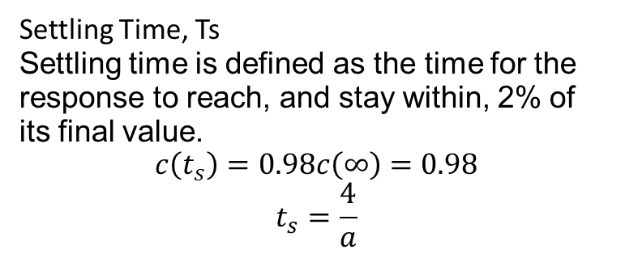
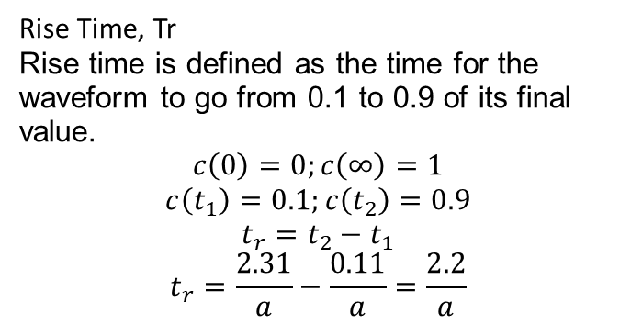
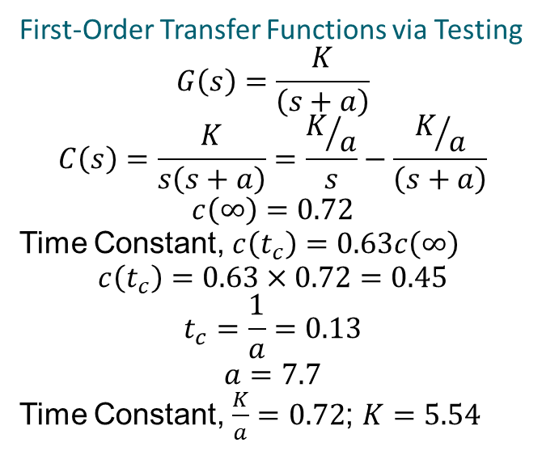
First-Order Systems
Rise Time, Tr
Rise time is defined as the time for the waveform to go from 0.1 to 0.9 of its final
value.
$$c\left(0\right)=0;c\left(∞\right)=1$$
$$c\left(t_{1}\right)=0.1;c\left(t_{2}\right)=0.9$$
$$t_{r}=t_{2}−t_{1}$$
$$t_{r}=\frac{2.31}{a}−\frac{0.11}{a}=\frac{2.2}{a}$$
Settling Time, Ts
Settling time is defined as the time for the response to reach, and stay within, 2% of
its final value.
$$c\left(t_{s}\right)=0.98c\left(∞\right)=0.98$$
$$t_{s}=\frac{4}{a}$$
First-Order Transfer Functions via Testing
$$G\left(s\right)=\frac{K}{\left(s+a\right)}$$
$$C\left(s\right)=\frac{K}{s\left(s+a\right)}=\frac{K/a}{s}−\frac{K/a}{\left(s+a\right)}$$
$$c\left(∞\right)=0.72$$
Time Constant, $c\left(t_{c}\right)=0.63c\left(∞\right)$
$$c\left(t_{c}\right)=0.63×0.72=0.45$$
$$t_{c}=\frac{1}{a}=0.13$$
$$a=7.7$$
Time Constant, $\frac{K}{a}=0.72$; $K=5.54$
Skill-Assessment Exercise 4.2

Slide 8


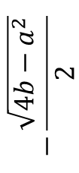
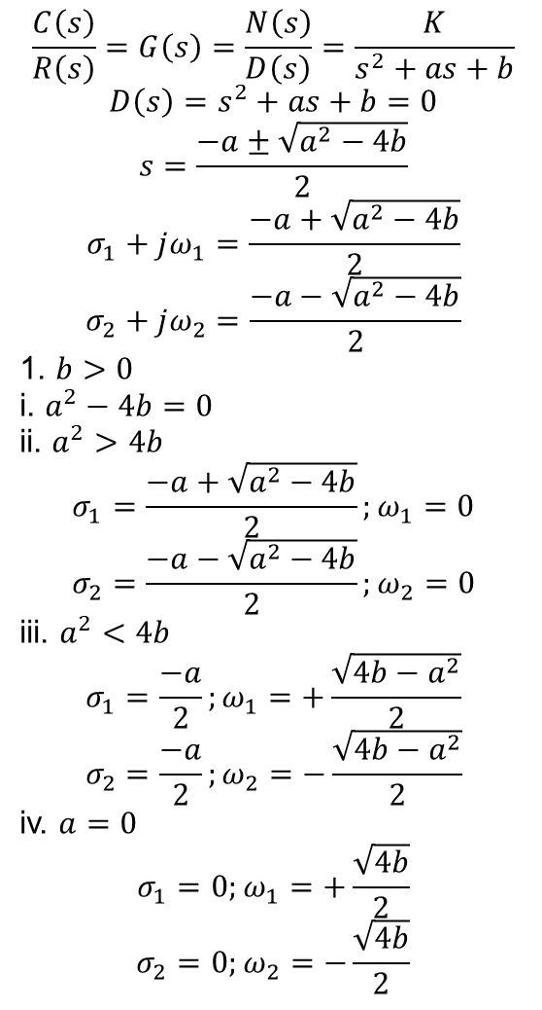
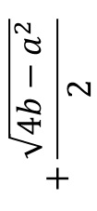


Second-Order Systems: Introduction
$$\frac{C\left(s\right)}{R\left(s\right)}=G\left(s\right)=\frac{N\left(s\right)}{D\left(s\right)}=\frac{K}{s^{2}+as+b}$$
$$D\left(s\right)=s^{2}+as+b=0$$
$$s=\frac{−a±\sqrt{a^{2}−4b}}{2}$$
$$σ_{1}+jω_{1}=\frac{−a+\sqrt{a^{2}−4b}}{2}$$
$$σ_{2}+jω_{2}=\frac{−a−\sqrt{a^{2}−4b}}{2}$$
1. $b>0$
i. $a^{2}−4b=0$
ii. $a^{2}>4b$
$$σ_{1}=\frac{−a+\sqrt{a^{2}−4b}}{2};ω_{1}=0$$
$$σ_{2}=\frac{−a−\sqrt{a^{2}−4b}}{2};ω_{2}=0$$
iii. $a^{2}<4b$
$$σ_{1}=\frac{−a}{2};ω_{1}=+\frac{\sqrt{4b−a^{2}}}{2}$$
$$σ_{2}=\frac{−a}{2};ω_{2}=−\frac{\sqrt{4b−a^{2}}}{2}$$
iv. $a=0$
$$σ_{1}=0;ω_{1}=+\frac{\sqrt{4b}}{2}$$
$$σ_{2}=0;ω_{2}=−\frac{\sqrt{4b}}{2}$$
jw
+1.iii
X
$$+\frac{\sqrt{4b−a^{2}}}{2}$$
$${1.i}^{2}$$
+1.ii
σ
-1.ii
X
$$\frac{−\sqrt{a^{2}−4b}}{2}$$
X
$$\frac{+\sqrt{a^{2}−4b}}{2}$$
X
$$1.i$$
$$−\frac{\sqrt{4b−a^{2}}}{2}$$
X
-1.iii

Slide 9
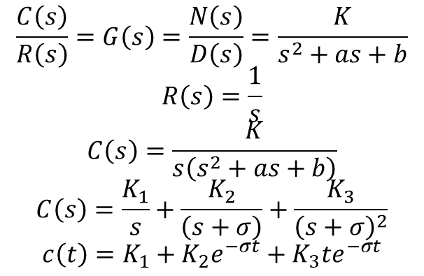
Second-Order Systems: Introduction
$$\frac{C\left(s\right)}{R\left(s\right)}=G\left(s\right)=\frac{N\left(s\right)}{D\left(s\right)}=\frac{K}{s^{2}+as+b}$$
$$R\left(s\right)=\frac{1}{s}$$
$$C\left(s\right)=\frac{K}{s\left(s^{2}+as+b\right)}$$
$$C\left(s\right)=\frac{K_{1}}{s}+\frac{K_{2}}{\left(s+σ\right)}+\frac{K_{3}}{{\left(s+σ\right)}^{2}}$$
$$c\left(t\right)=K_{1}+K_{2}e^{−σt}+K_{3}te^{−σt}$$
jw
$${1.i}^{2}$$
σ
X
X
$$1.i$$
Case 1.i

Slide 10
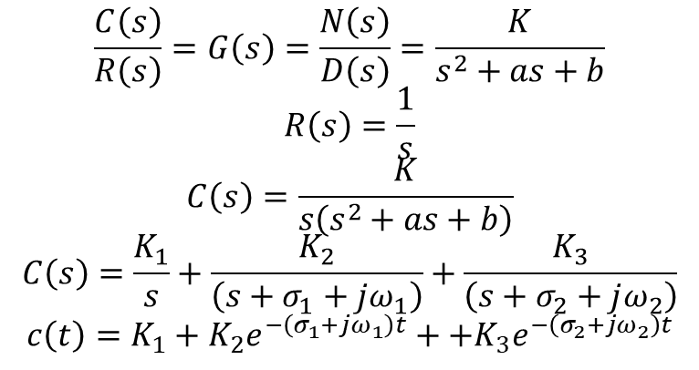
Second-Order Systems: Introduction
$$\frac{C\left(s\right)}{R\left(s\right)}=G\left(s\right)=\frac{N\left(s\right)}{D\left(s\right)}=\frac{K}{s^{2}+as+b}$$
$$R\left(s\right)=\frac{1}{s}$$
$$C\left(s\right)=\frac{K}{s\left(s^{2}+as+b\right)}$$
$$C\left(s\right)=\frac{K_{1}}{s}+\frac{K_{2}}{\left(s+σ_{1}+jω_{1}\right)}+\frac{K_{3}}{\left(s+σ_{2}+jω_{2}\right)}$$
$$c\left(t\right)=K_{1}+K_{2}e^{−\left(σ_{1}+jω_{1}\right)t}++K_{3}e^{−\left(σ_{2}+jω_{2}\right)t}$$
jw
+1.iii
X
$$+\frac{\sqrt{4b−a^{2}}}{2}$$
$${1.i}^{2}$$
+1.ii
σ
-1.ii
X
$$\frac{−\sqrt{a^{2}−4b}}{2}$$
X
$$\frac{+\sqrt{a^{2}−4b}}{2}$$
X
X
$$1.i$$
$$−\frac{\sqrt{4b−a^{2}}}{2}$$
X
Case 1.ii & 1.iii
-1.iii

Slide 11
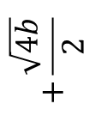



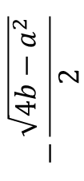
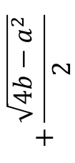

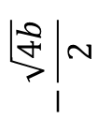
Second-Order Systems: Introduction
jw
+1.iii
X
jw
$$+\frac{\sqrt{4b−a^{2}}}{2}$$
+1.iv
X
$${1.i}^{2}$$
+1.ii
σ
$$+\frac{\sqrt{4b}}{2}$$
-1.ii
X
$$\frac{−\sqrt{a^{2}−4b}}{2}$$
X
$$\frac{+\sqrt{a^{2}−4b}}{2}$$
X
$$1.i$$
σ
$$−\frac{\sqrt{4b−a^{2}}}{2}$$
X
Case 1.iv
-1.iii
$$−\frac{\sqrt{4b}}{2}$$
X
-1.iv

Slide 12


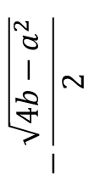
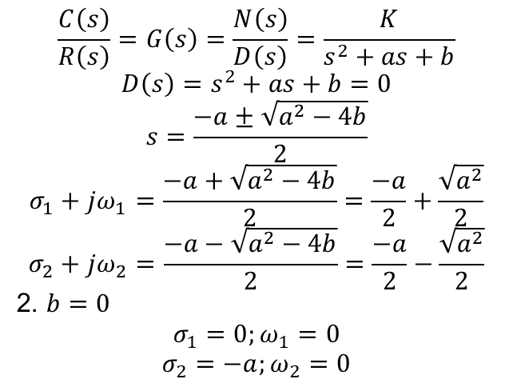
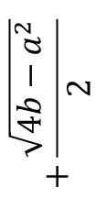

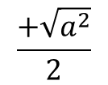

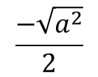
Second-Order Systems: Introduction
jw
jw
+1.iii
X
$$+\frac{\sqrt{4b−a^{2}}}{2}$$
$${1.i}^{2}$$
+1.ii
σ
+2
σ
-1.ii
X
$$\frac{−\sqrt{a^{2}−4b}}{2}$$
X
$$\frac{+\sqrt{a^{2}−4b}}{2}$$
X
-2
X
$$\frac{−\sqrt{a^{2}}}{2}$$
X
$$\frac{+\sqrt{a^{2}}}{2}$$
X
$$1.i$$
$$−\frac{\sqrt{4b−a^{2}}}{2}$$
$$\frac{C\left(s\right)}{R\left(s\right)}=G\left(s\right)=\frac{N\left(s\right)}{D\left(s\right)}=\frac{K}{s^{2}+as+b}$$
$$D\left(s\right)=s^{2}+as+b=0$$
$$s=\frac{−a±\sqrt{a^{2}−4b}}{2}$$
$$σ_{1}+jω_{1}=\frac{−a+\sqrt{a^{2}−4b}}{2}=\frac{−a}{2}+\frac{\sqrt{a^{2}}}{2}$$
$$σ_{2}+jω_{2}=\frac{−a−\sqrt{a^{2}−4b}}{2}=\frac{−a}{2}−\frac{\sqrt{a^{2}}}{2}$$
2. $b=0$
$$σ_{1}=0;ω_{1}=0$$
$$σ_{2}=−a;ω_{2}=0$$
X
X
-1.iii

Slide 13

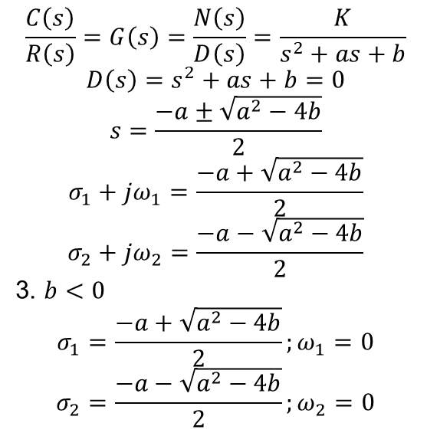

Second-Order Systems: Introduction
$$\frac{C\left(s\right)}{R\left(s\right)}=G\left(s\right)=\frac{N\left(s\right)}{D\left(s\right)}=\frac{K}{s^{2}+as+b}$$
$$D\left(s\right)=s^{2}+as+b=0$$
$$s=\frac{−a±\sqrt{a^{2}−4b}}{2}$$
$$σ_{1}+jω_{1}=\frac{−a+\sqrt{a^{2}−4b}}{2}$$
$$σ_{2}+jω_{2}=\frac{−a−\sqrt{a^{2}−4b}}{2}$$
3. $b<0$
$$σ_{1}=\frac{−a+\sqrt{a^{2}−4b}}{2};ω_{1}=0$$
$$σ_{2}=\frac{−a−\sqrt{a^{2}−4b}}{2};ω_{2}=0$$
jw
+3
σ
-3
X
$$\frac{−\sqrt{a^{2}−4b}}{2}$$
X
$$\frac{+\sqrt{a^{2}−4b}}{2}$$
X

